Slide 1
Optimizing Microsite Architectures
With Webpack Module Federation
Ideas by Zack Johnson, inventor of Module federation / Principal @Lululemon,
and Jack Herrington, author of Module Federation Dashboard / Principal @Nike.
R+D and presentation by Alex Bennett

Slide 2
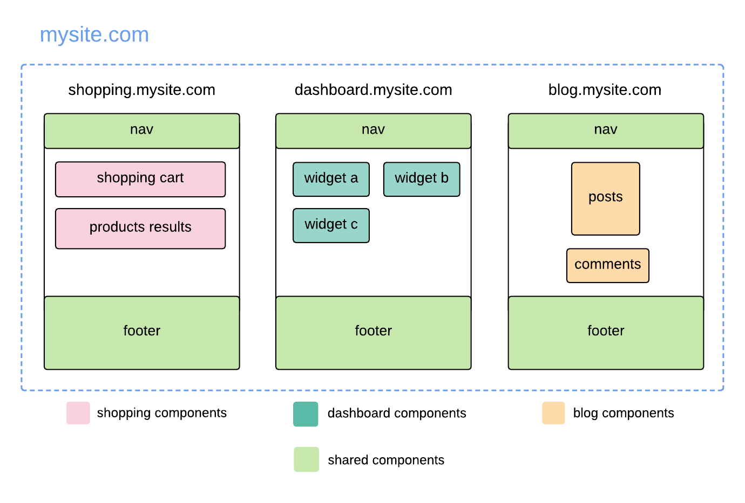
Microsite
Many stand-alone websites hosted under the same domain.
In this example we have
shopping
dashboard
blog
sites hosted under mysite.com.

Slide 3
Pros
Each site is independently deployed.
Each site is independently maintained.
Code can be shared through shared dependencies (see light green).
Other benefits of Domain Driven Design like clearer boundaries of responsibility.

Slide 4
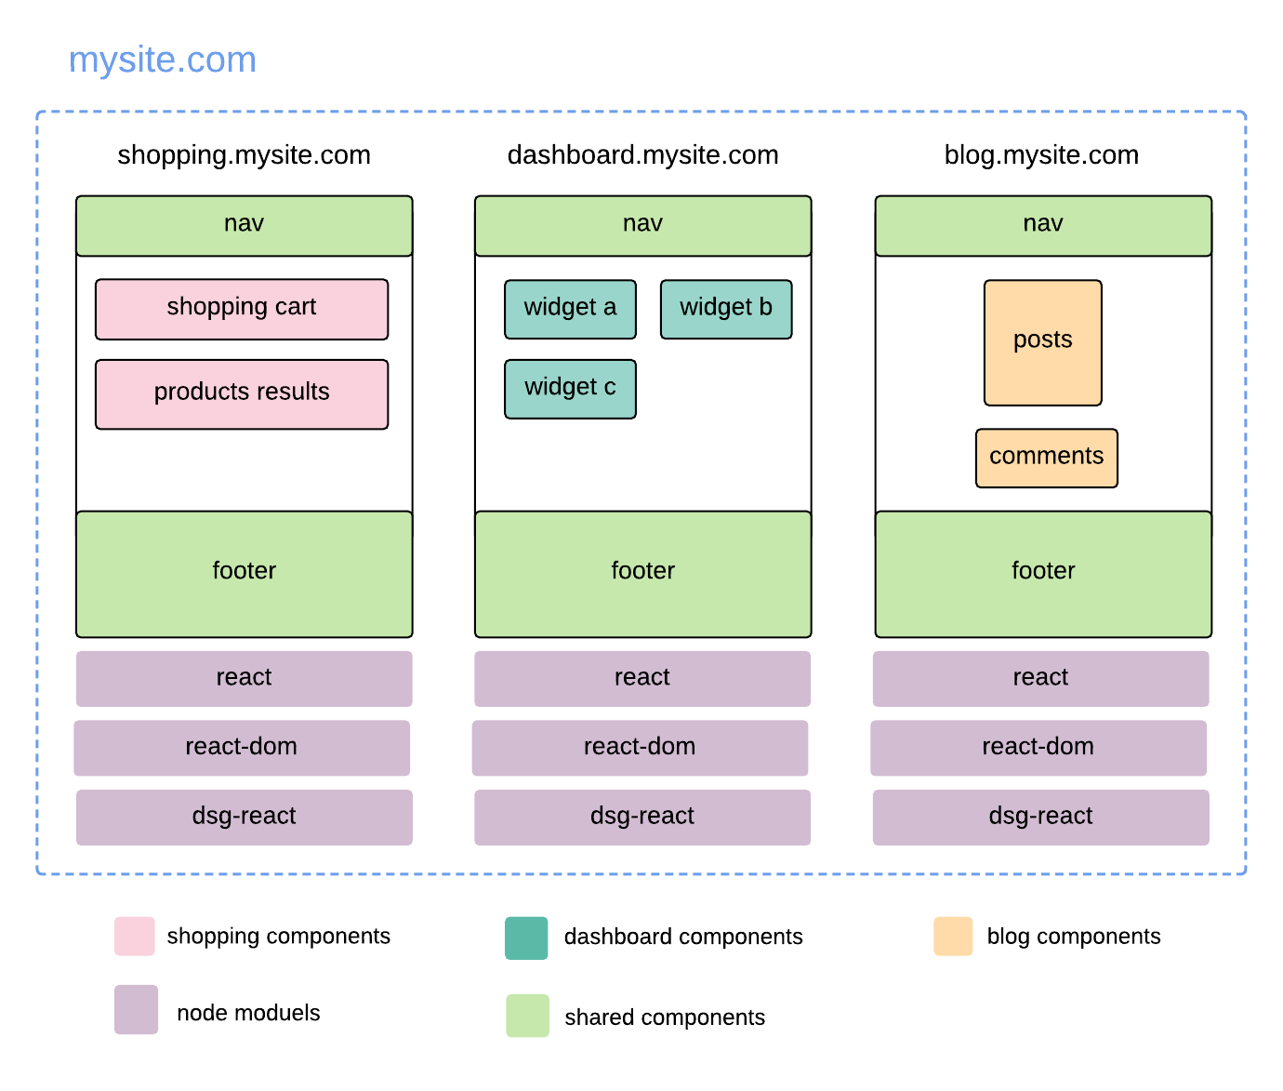
Cons
Updates to shared deps require new deploys from consuming microsites.
User’s browser redownloads shared deps as they navigate between sites.
Individual application bundles tend to be bigger, increasing load times.
Any identical functionality that isn’t in the shared lib will be duplicated.

Slide 5
Why does this matter?
🤔
Let's take a look at a hypothetical situation

Slide 6
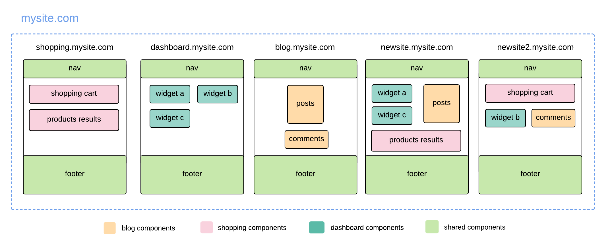
New Requirements
Notes:
Assumptions we are making are that these are all static, client rendered apps

Slide 7
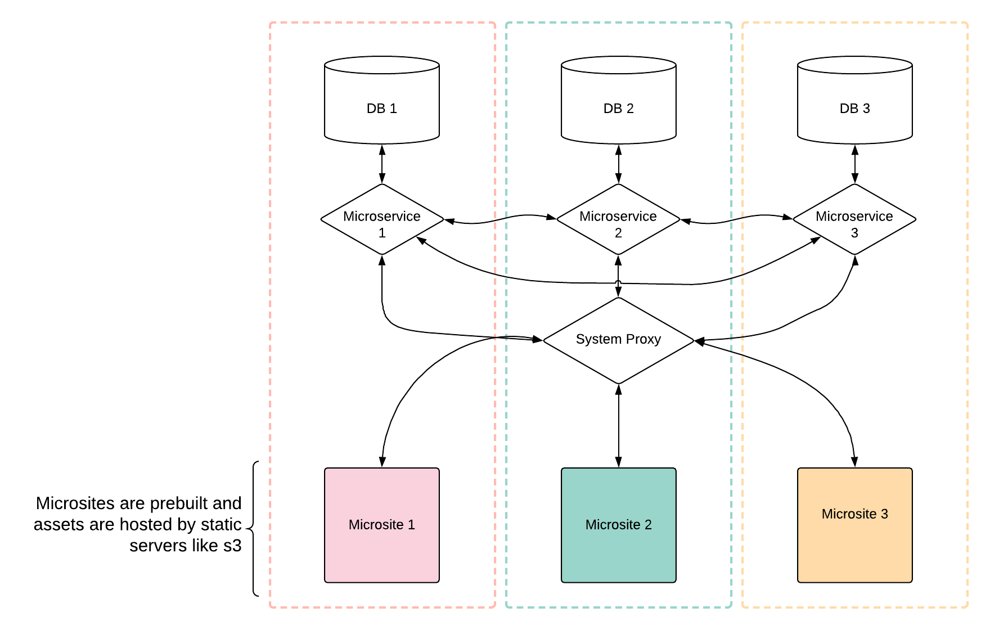
Assumptions
Apps are static, pre-built, client-side html/css/js bundles that are rendered by the browser.

Slide 8
Options
1) Share dependencies:
Package existing components as node modules.
2) Don’t share dependencies:
Rewrite that functionality with every new app.

Slide 9
What if we could share code differently?
🤔
Let's take a look at a real-world implementation

Slide 11
Surprise! The business just came in with new requirements for two new websites.
Each website has the need for components that already exist.
Do we put those components in npm modules? Do we duplicate that code?
What are our current options with this traditional approach?

Slide 12
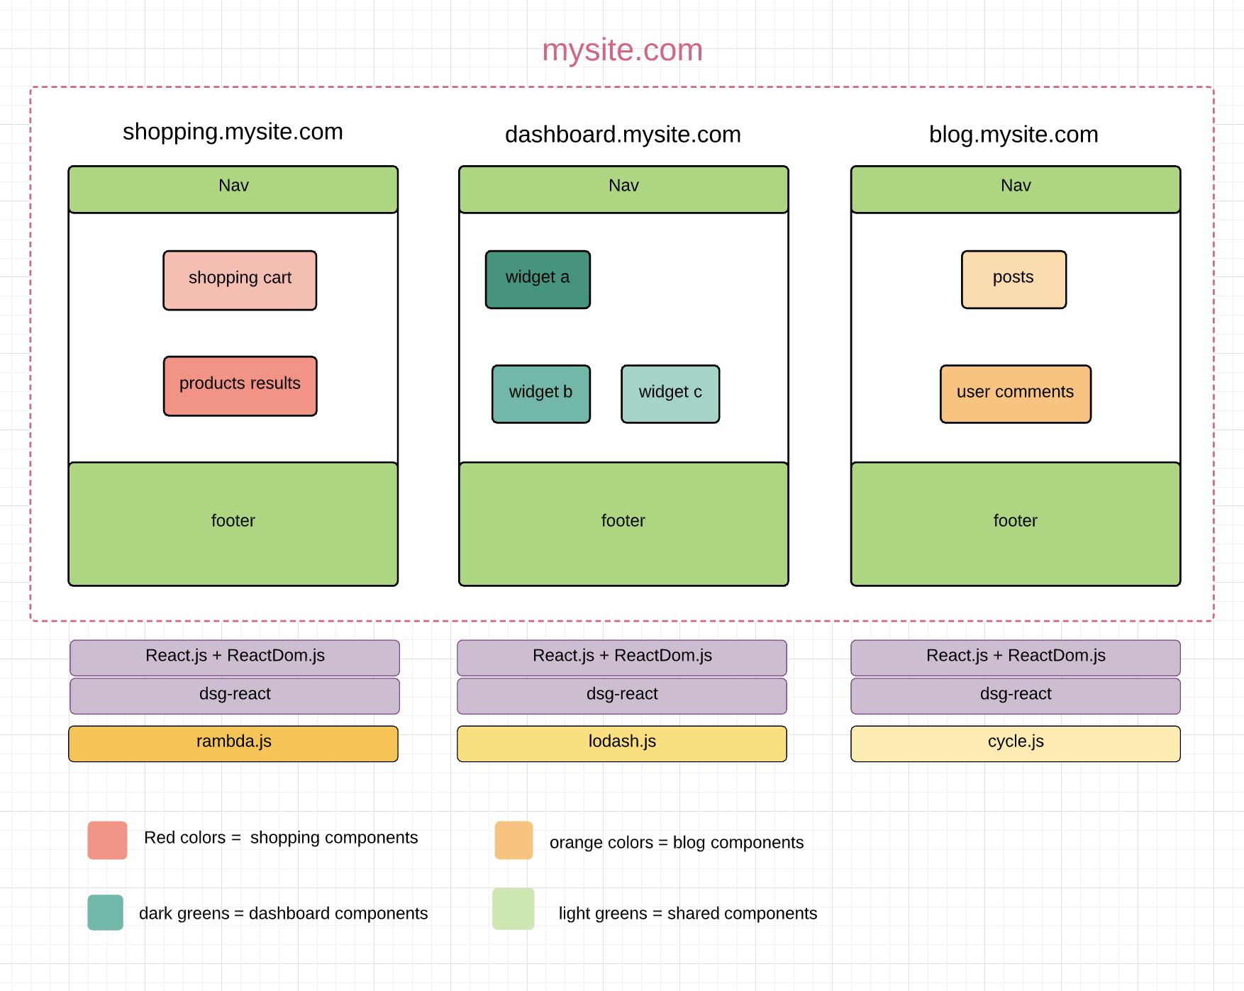
What are the possibilities?
One of the very exciting possibilities of our current microsite architecture is that it can be extended to make code sharing easier across independent applications.
But, aren’t we already sharing code between our apps? Why would we want to change the way we are already doing this?

Slide 13
Code Sharing Currently:
The way we are currently sharing code is through NPM Modules.
Modules are published to a central repository
Modules are downloaded by developers
Modules are bundled into our application source code at compile time by webpack.
Finally, built app code is deployed, and bundled module code is then downloaded and executed alongside the rest of the application at the same time at runtime.

Slide 14
Why is this not optimal?
Any time a shared packages gets updated, the consuming microsites must redownload the dependency, recompile the app source code to bundle it in, and redeploy the app. Furthermore, once the site has been deployed, no further configuration can be made to the dependency during runtime. In addition to this, microsites that share the same shared dependencies will have to redownload each shared module as the user navigates around the megasite. This is sure to retry the patience of our users every step of the way.
Notice all the (re-) words in there? What if we didn’t have to do any of those things anytime a shared dependency changes?

Slide 15
Code Sharing in the Future
Rather than download and bunde our shared code dependencies into our applications at compile time...
Future of code sharing is: requesting shared code over http at runtime.

Slide 16
Wat?
You’re telling me that we’re going to fetch js code with js code, just as we’re fetching data but instead we’re going to execute the code we are requesting?
Are we really going to use http calls to load code that will go on to make more http calls?
How the heck?

Slide 17
Yes.
That’s exactly what we’re going to do, we’re going to treat our shared application code exactly like data. We’re going to request it over HTTP, and we’re going to load it into our app and execute it.
OK, but, thats sounds like a lot of http calls. You are correct! (Hold on to that thought for later.)
Concerns aside: how is this even possible? Why would we even want this? Show me something!

Slide 18
Why dynamic code sharing is exciting:
With this new approach to code sharing, we can begin to think about each one of our disperate microsites as its own component or set of components which can be mixed and matched N number of ways.
Even as components from microsites or even entire microsites are shared with others each microsite will maintain its integrity as fully functioning stand-alone app
For example: if what we have today is the collection of microsites in this image to the right, let’s explore a real world use case of how this architecture support handle future business requirements. (See next slide)

Slide 19
Module federation
Module federation works by making your app bundle accessible to other apps. In turn, module federation can also request the code of another app, whos bundle has also been made accessible. The sharing and consuming relationship of federated app can be uni or bi-directional. Module federation will also handle circular dependencies.

